Slide 1
Yoga: The art of happiness
An ounce of practice is worth more than a ton of theory

Slide 2
Yoga Sutra: Patanjali
400 years BC (5000 BC- 50 AC)
collection of 196 sutras (aphorisms)
considered to be the most scientific and precise text about yoga ever written
Contains four chapters:
Samadhi Pada (super-consciousness)
Sadhana (practice)
Vibhuti (psychic power)
Kaivaly (non-duality)

Slide 3
Patanjali’s definition of Yoga
“Yogas chitta vritti nirodhah”
Or:
“Yoga is the stopping/controlling of the fluctuation of the mind.”
chitta = mind
vrittis = fluctuation /modification of the mind
nirodhah = control

Slide 4
Patanjali’s Stages of Yoga
Exoteric (exterior) stages of yoga: Bahiranga
Yama – the social code – attitudes and rules of interaction with others
Niyama – the personal code - attitudes and rules to adopt for ourselves
Asanas – physical postures
Pranayama – breath control
Pratyahara – withdrawing the senses
Esoteric (interior) stages of yoga: Antaranga
6. Dharana – concentration of the mind
7. Dhyana – meditation
8. Samadhi – super-consciousness

Slide 5
Yama: The social code
1. Ahimsa:
Non-violence
2. Satya:
The truth
3. Brahmacarya: Control of sexual function
4. Asteya:
Non-stealing
5. Aparigraha: Non-accumulating

Slide 6
1. Ahimsa: Non-violence
Not killing
Not having violent thoughts
Not having violent intentions
Having a considerate attitude; not harming others
Kindness; friendliness
Thoughtful consideration of other people and things
Love
Effects of Ahimsa: eliminating violence around you

Slide 7
2. Satya: The truth
Not speaking the truth can misguide others and ourselves in the end
If speaking the truth has negative consequences for another, then it is better to say nothing (not breaking ahimsa - non-violence)
The truth can be relative in our world of opposite poles or duality (there is always a bigger or another truth that takes the place of the previous one).
Essentially the truth is one with our inner Consciousness – called Atman or Superior Self.
Yoga Sutra: “The one who constantly practices Satya acquires the results of his actions that depend completely on his will.”
Vaksiddhi: the power to materialize what we are saying.

Slide 8
3. Asteya: Non-stealing
Taking nothing that does not belong to us
Not taking what belongs to another without permission, and not using something for a different purpose to that intended, or beyond the time permitted by its owner
If we ask for others’ time when it is not freely given, it is, in effect, stealing.
Also renouncing desires
Effects: development of clairvoyance or intuition, discovering precious treasures around yourself

Slide 9
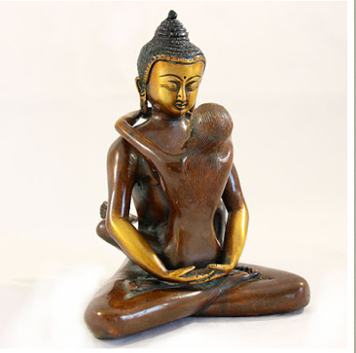
4. Brahmacharya: Control of sexual function
Brahmacharya: retention, stopping, abstinence
Literally means wise use of sexual energy (brah-muh-char-yuh)
Controlling or preserving sexual energy (not ejaculating or preserving feminine sexual fluids) allows control of all other types of energies because sexual energy is the most powerful of all energies (it can create life)
Wise use= transforming our sexual energy into love, mental or spiritual energy (by transmutation and sublimation)
Abstinence - not having sexual relations (except involuntary ejaculation)

Slide 10
4. Brahmacharya: Control of sexual function
Sexual continence – controlling sexual function and not ejaculating during love-making (preserves sperm and feminine sexual fluids)
India: Brahmacharya; China: Tao tradition; Arabic culture: Imsak
The orgasm is separated from ejaculation and the act of making love can continue indefinitely, producing a huge quantity of inner energy and multiple orgasms
Women can practice sexual continence more easily. For men it requires more effort and discipline in yoga practice.
Yoga practice helps to gain a perfect control of sexual potential.
We use our sexual energy to regenerate ourselves, maintain a good state of health and connect to our spiritual self.
More than 250 effects: “Those who practice brahmacharya acquire great power.” (Yoga Darshana)

Slide 11
5. Aparigraha: Non-accumulation
Taking only what is necessary, and not taking advantage of a situation or acting greedily
Taking only what we have earned
Many possessions lead to many worries, and energy spent to maintain the accumulated objects
If we need more, the Universe will provide for us.
Effects: acquiring the ability to see previous lives. When everything is lost, what stays is the immortal Spirit, or Atman, which passes from one life to another, to another….

Slide 12
Nyiama: The personal code
Sauca:
Purity
Santosa: Contentment
Tapas: Disciplined use of our energy
Svadhyaya: Self-study
Isvarapranidhana:: Celebration of the Supreme Consciousness

Slide 13
1. Saucha: Purity
Cleanliness
Cleansing of inner and an outer aspects
Cleansing the exterior: physical exercises or techniques of purification
Cleansing the interior: clearing the mind of disturbing emotions like hatred, passion, anger, lust, greed, delusion and pride.

Slide 14
2. Santosa: Contentment
Modesty; being content with what we have
Acceptance of events we face, but preparing to transform what we can transform
Experiencing life’s difficulties - we have the opportunity to grow
Understanding that there is a purpose for everything, even if the whole picture is not revealed to us
Being happy with what we have, rather than unhappy about what we don't have
Contentment is a inner quality not dependent on exterior circumstances

Slide 15
3. Tapas: Austerity
Disciplined use of our energy
Literally to heat, put on a flame, being burned
The conscious effort to accomplish a spiritual goal (ultimate goal is fusion with the Superior Consciousness) and burn up all the inferior desires that stand in our way
This effort implies our transformation through the practice of the stages of yoga: following yama and nyiama, postures, pranayama, meditation, etc.
Such efforts must be done whether the exterior conditions are good or not

Slide 16
4. Svadhyaya: Self-study
Sva = Self; adhyaya = examination/study
“Education for self-revelation”
The study of sacred texts that give us reflections about the Self : Yoga-Sutra, Bhagavat-Gita, Siva Samhita, Hatha Yoga Pradipika, the Bible, the Koran, etc.
Any activity that cultivates self-reflective consciousness and self-awareness
“Know yourself and you will know the entire universe”

Slide 17
5. Isvarapranidhana: Celebration of the Supreme Consciousness
Ishvara = last degree in a hierarchy, God, Superior Self Atman, Supreme Consciousness
Pranidhana = continuous devotion
To make a continuous effort to reach the state of Supreme Consciousness
The contemplation of Isvara/ Supreme Consciousness in order to become attuned to it.

Slide 18
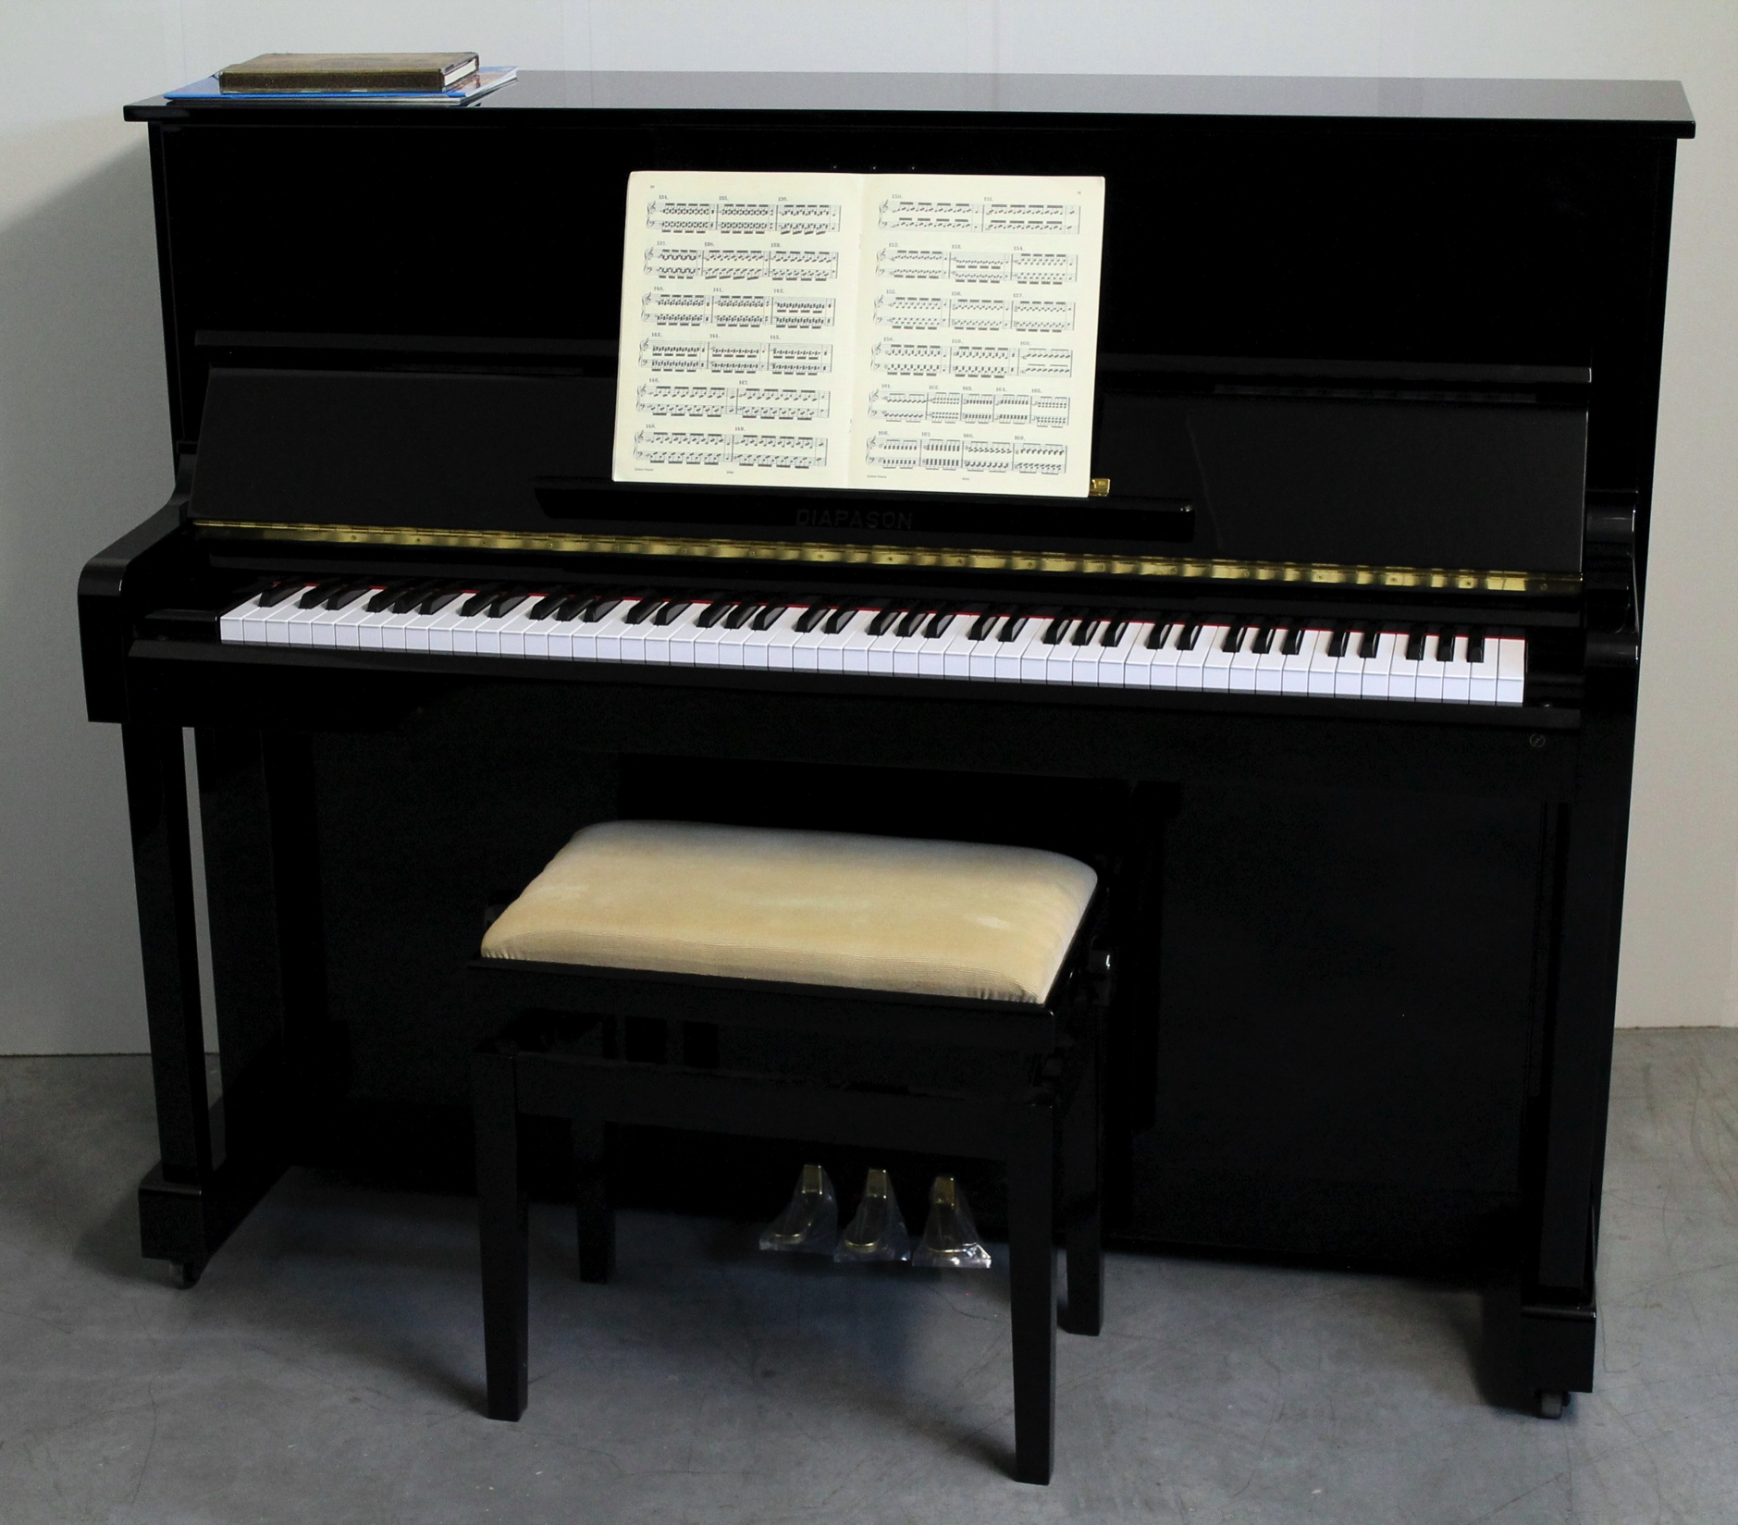
Postures
Asana = simultaneous effort of our body, mind and soul to vibrate in unison with the infinity.
Through resonance in our body, we receive specific energy from the Universe.

Slide 19
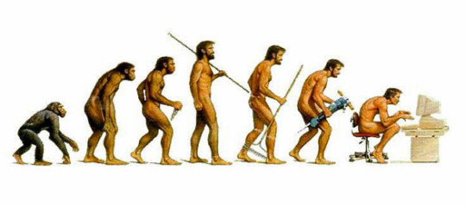
Postures
Our brain receives impulses from stretching the tendons and muscles and transforms the inner state, acting on the level of the subconscious

Slide 20
Thank you !
www.yogaintegral.ch

